Slide 1


BUSINESS INTELLIGENCE INTERN ASSIGNMENT
ZAPPOS
BUSINESS INTELLIGENCE INTERN ASSIGNMENT
BHARAT DEVAGUPTAPU

Slide 2

What’s in the Presentation ?
Addressing specific set of problems related to Zappos business sector.
PROBLEM STATEMENT :
Zappos is interested in attracting new customers to its website.
There is a missing demographic that will add the highest dollar value to the company.
Value Propositions to attract and maintain.

Slide 3
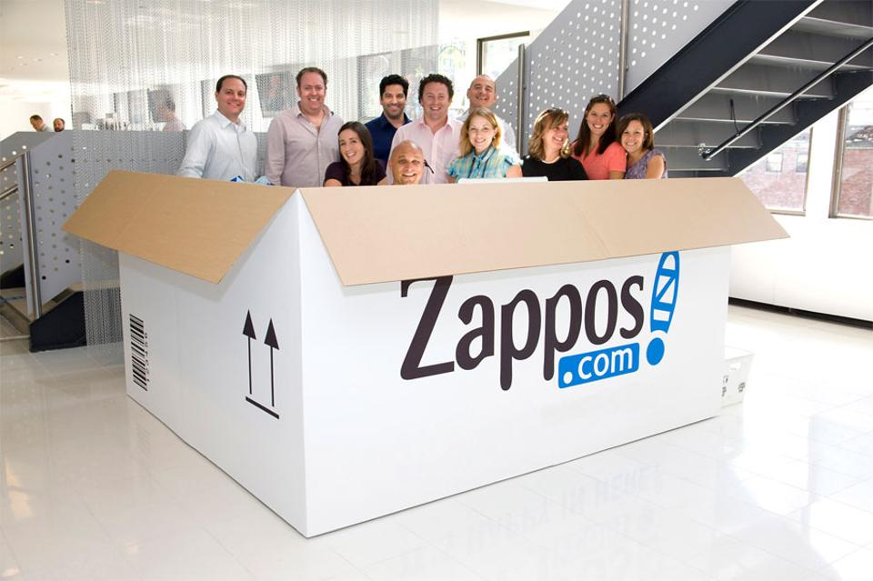
INTRODUCTION
Demographics is a statistical data relating to the population and particular groups within it.
Demographics allows you to create segments to identify specific consumer markets.
Zappos is innovative,fast growing
E-commerce company which sells
Shoes,clothes,Bags etc.
Analyzing Zappos.com website
Users, with demographics
age,Gender,Education to bring
new set of customers.

Slide 4
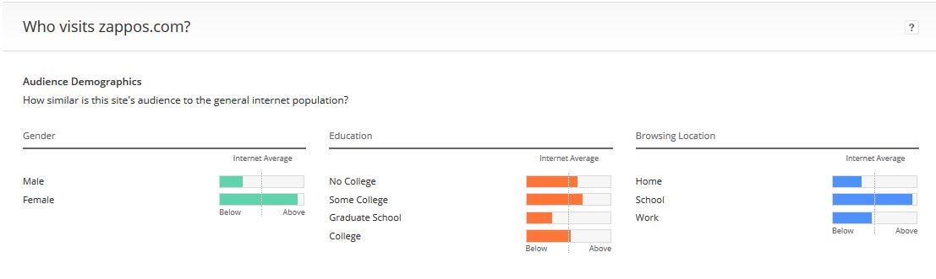
ZAPPOS DEMOGRAPHICS
nnn
The core demographics for Zappos are females, with the browsing location being mostly school, and the education levels being highest in those that are in college.
Old target(2010) : Women aged 25-49 years, who are married,
educated, parents, salary of 75k+,known as ‘happy hunter’.
Expected current target: Women 18-49 years,educated,
In some college as well as not in college

Slide 5



MISSING DEMOGRAPHICS
How Does Missing Demographics look like ?
From the above seen Zappos demographics information we can determine the missing customer demographics will be Men, Aged between 18-64 who are educated.

Slide 6
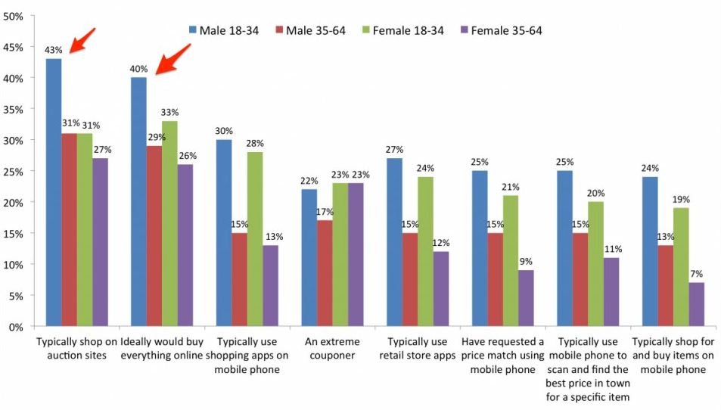
LIFESTYLE & SPENDING BEHAVIOURS
From a recent Ecommerce demographics report it is found that men are actually more likely to shop than women
Men aged 18 to 34 would like to shift all their spending online. They also use auction sites.

Slide 7
AGE DEMOGRAPHICS AND SEGMENTATION
Generation Z : People born after 2000’s.They won't directly make online purchases but they have a major influence on the parents.
Millennials : There are roughly 75 million millennials in the United States, defined as people aged 18-34,also known Generation Y. They are are generally proficient with technology and more optimistic about the future.
Generation X : Age group of 35-50. Gen X is now beginning to occupy higher and higher positions on the corporate ladder and having children of their own. They consists of parents, homeowners, managers and executives in many instances.

Slide 8
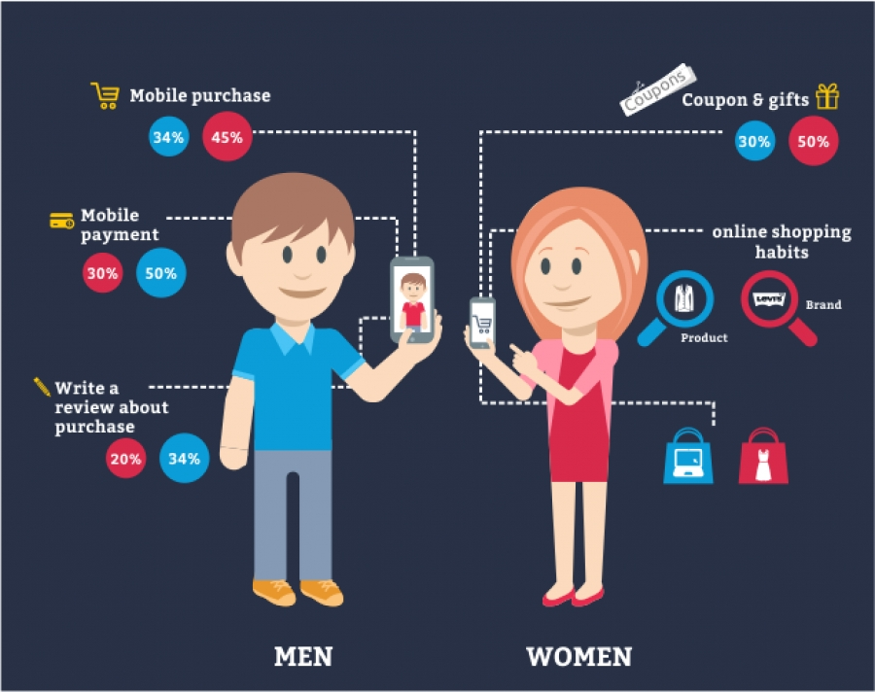

HOW DO THEY DIFFER FROM OTHER GROUPS?

Slide 9
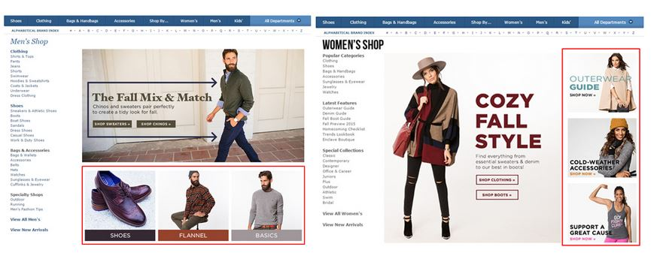
SOLUTION TO BEST SERVE THIS GROUP
We should raise awareness through advertising,concentrate on features.
For below 18 years: They depend more on user reviews and online searches so we should concentrate on improving search results and reviews.
For 18 -34 years: They depend more on coupons,discounts ,incentives,reviews.So we should provide more discounts and cashback offers and more incentive methods.
For 35-64 years: They are on saving mode and depend on word of mouth. So we should provide better service and provide econmial range of products.

Slide 10
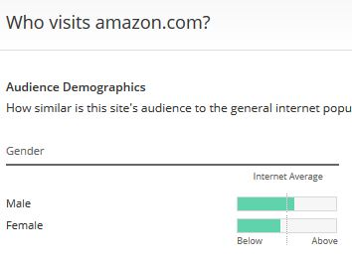
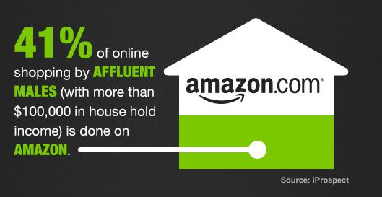
COMPETITORS
There are lot of competitors to Zappos, but still Zappos stands a leading website because of its customer service and core values.
Nordstrom,Shoebuy.com,JCpenney,bagsbuy.com
Top five competitors include: JustFab,Spartoo,Amazon,Zulily,Gilt Groupe.

Slide 11
VALUE PROPOSITIONS
They are many facts that support the solutions suggested
Some of the facts include:
44% of males, use major search engines to shop.
50% of male aged 24 to 40 are influenced by digital ads and banners.
Data provided by comScore,shows that there are 19 million affluent males online, 40% of whom are shopping online twice a week or more. The top website visited in the group surveyed was Amazon.com.

Slide 12


